Slide 1





Late post operative complications and management
Luigi Piazza
Direttore U.O.C. Chirurgia Generale
A.R.N.A.S. Garibaldi, Catania

Slide 2
OAGB…
… a growing surgical experience
Notes:
One Anastomosis Gastric Bypass (OAGB) is a hypoabsorptive procedure first described by Robert Rutledge in
1997 and has since evolved into one of the most commonly
performed metabolic bariatric procedures worldwide [1, 2].
Its single gastrojejunal anastomosis, shorter operative time,
and sustained weight-loss outcomes have contributed to its
growing popularity

Slide 3

OAGB prevalence…
The prevalence of OAGB continues to rise
It now accounts for 7.6% of all bariatric procedures worldwide, reaching 14.9% in Europe and 16% in the Asia-Pacific regions
Angrisani L, Santonicola A, Iovino P, et al. IFSO worldwide survey 2020–2021: current trends for bariatric and metabolic procedures. Obes Surg. 2024;34(4):1075–85. https://doi.org/10.1007/s 11695-024-07118-3

Slide 4

Long-term outcomes play a key role in assessing the
proper safety and efficacy of metabolic and bariatric procedures
As evidence accumulates from cohorts with more than a decade of follow-up, our understanding of OAGB’s long-term safety profile continues to evolve, helping define its role in the modern era of Metabolic and Bariatric Surgery (MBS).
Brown R. Evaluating the effectiveness and Long-term outcomes of Roux-en-Y gastric bypass vs gastric sleeve bariatric surgery in
obese and diabetic patients: systematic review. J Am Coll Surg. Published Online July 25, 2025. https://doi.org/10.1097/XCS.00

Slide 5
  Late Complications after OAGB
Late Complication | Incidence (%) | Source / Literature Reference
Biliary Reflux | 4% - 10% | Mitra et al. (2025); Voon et al. (2021)
Marginal Ulcer | 1% - 6% | El Ghazal et al. (2025); Voon et al. (2021)
Anastomotic Stenosis | 1.5% - 4.5% | Musella et al. (2017)
Malnutrition | 1% - 2.3% | Carandina et al. / Mitra et al. (2025)
Insufficient Weight Loss / Regain | 7.2% - 33.4% | Victor Liew Review / Long-term Data
Need for Revision Surgery | 2.3% - 4.7% | Voon et al. (2021); Mitra et al. (2025)
Summary of late complications based on published pooled data.

Slide 6
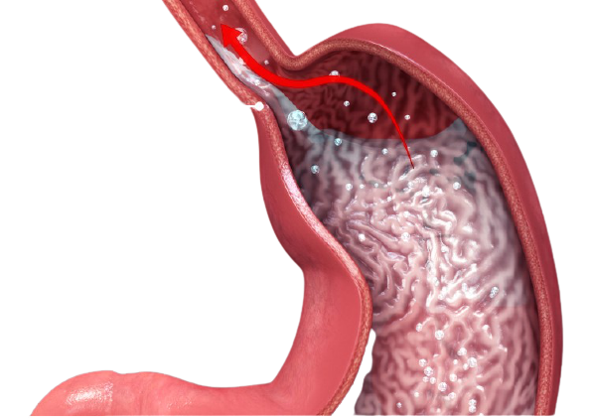
  BILE REFLUX
  (Duodeno-gastro-esophageal reflux)
Reflux of duodenal contents
(bile, bicarbonate, pancreatic enzymes)
into the stomach and esophagus
Eldredge TA, Myers JC, Kiroff GK, Shenfine J. Detecting Bile Reflux-the Enigma of Bariatric Surgery
Obes Surg. 2018 Feb;28(2):559-566. doi: 10.1007/s11695-017-3026-6. PMID: 29230622

Slide 7
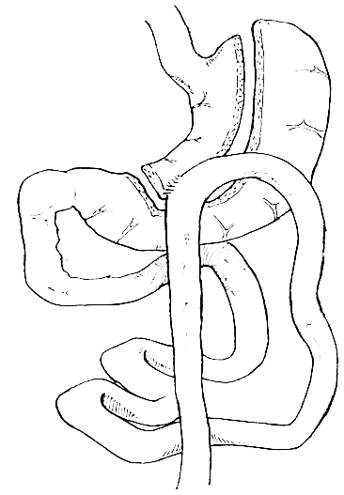
The esophageal mucosa is not predisposed to be able to manage
any DGER for a postprandial period of more than a few minutes
OAGB/MGB remains controversial because of the potential long-term consequences of biliary reflux in the upper gastrointestinal tract (metaplasia, dysplasia, and cancer) due to omega loop reconstruction
M'Harzi L, Chevallier JM, Certain A, Autret G, Levenson G, Louis D, Poghosyan T, Berger A, Rahmi G, Broudin C, Clément O, Douard R, Tavitian B, Bruzzi M. Long-Term Evaluation of Biliary Reflux on Esogastric Mucosae after One-Anastomosis Gastric Bypass and Esojejunostomy
Rats. Obes Surg. 2020 Jul;30(7):2598-2605. doi: 10.1007/s11695-020-04521-4. PMID: 32130650

Slide 8
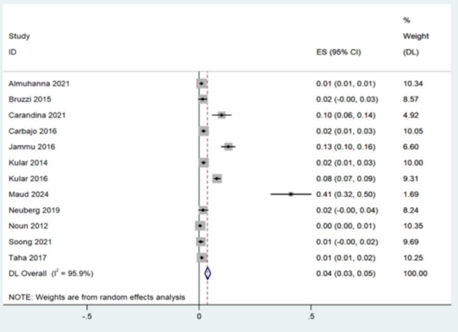
  Incidence
De novo bile reflux was reported in 4% of patients following OAGB
(95% CI: 3–5, I 2=96%, n=9,831)
Subgroup analysis by BPL length showed a lower incidence with a longer limb (≥200 cm), where 2% of patients developed bile reflux, in contrast, a shorter BPL length was associated with an risk of bile reflux at 5%
Long‑Term Outcomes of One Anastomosis Gastric Bypass: A Systematic Review and Meta‑Analysis of 5‑Year and Beyond
Anuja Mitra, Amit Bhambr· Matyas Fehervari· Chetan Parmar, Obesity Surgery (2025) 36:71–87
https://doi.org/10.1007/s11695-025-08339-w

Slide 9
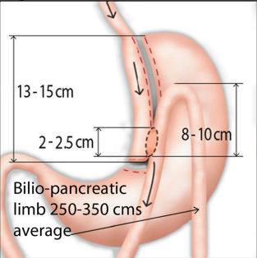
  But…
MGB’s anatomical configuration through its long, narrow, and vertical pouch, which is based on the lesser curvature, makes esophageal BR highly improbable
Several studies show a statistically significant correlation between the technical error in the creation of the gastric pouch / measurement of the bypass and the intractability of the
DGER in the post-operative. These errors usually occur in the initial period of the learning curve
Luque-de-León E, Carbajo MA. Conversion of One-Anastomosis Gastric Bypass (OAGB) Is Rarely Needed if Standard Operative Techniques Are Performed
Obes Surg. 2016 Jul;26(7):1588-91. doi: 10.1007/s11695-016-2172-6. PMID: 27067910

Slide 10
  THERAPEUTIC OPTIONS
Surgical approach used | Number/Percentage (total numer 339 patients)
RYGB | 272/80%
Braun enteroenterostomy | 28/8%
Reversal | 12/4%
LSG | 27/8%
Haddad, A., Bashir, A., Fobi, M. et al. The IFSO Worldwide One Anastomosis Gastric Bypass Survey: Techniques and Outcomes?
OBES SURG 31, 1411–1421 (2021)

Slide 11
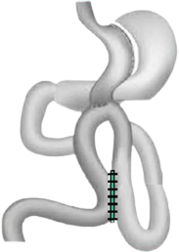
  Braun side-to-side jejuno-jejunostomy anastomosis
FAST TECHNIQUE
between 40 and 70 cm from the previous Gastroenteroanastomosis
RISK:
malabsorption due to the creation of a too short common food duct
bile not completely diverted
TOO SHORT GASTRIC POUCH IS A CONTRAINDICATION

Slide 12
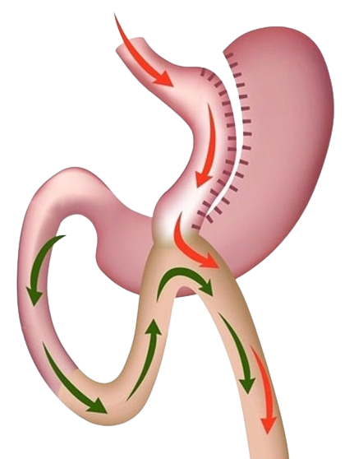
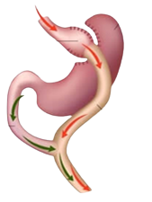
  Revision of the gastro-jejunostomy conversion to rygb
MOST COMMON SURGICAL PROCEDURE
1. Gastroenteric deconnection
2. Creation of 30-40 cm biliopancreatic limb
100 cm food limb
3. Antecolic GEA with/out shortening of gastric pouch
4. Closure of Petersen space
Khrucharoen U, Juo YY, Chen Y, Dutson EP. Indications, Operative Techniques, and Outcomes for Revisional Operation Following Mini-Gastric Bypass-One Anastomosis Gastric Bypass: a Systematic Review
Obes Surg. 2020 Apr;30(4):1564-1573. doi: 10.1007/s11695-019-04276-7. PMID: 31982993.

Slide 13

  OUR EXPERIENCE
TOTAL PATIENTS: 43/4032
Onset symptoms average 1 to 74 months
8 pz | MRGE previous to primary procedure
4 pz | From MGB/OAGB as revisional procedure
19 pz | From MGB/OAGB executed in other institution
PROCEDURES
7 pz | Braun side-to-side jejuno-jejunostomy anastomosis
24 pz | Revision of the gastro-jejunostomy conversion to RYGB
2 pz | Restoration of normal anatomy (because of concomitant malabsorption)

Slide 14
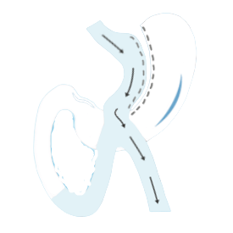
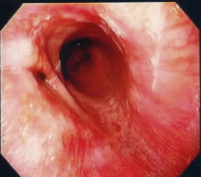
  MARGINAL ULCER (or stomal ulcer)
is defined as a ulcer produced on the jejunal mucosa distal to the gastro-jejunal anastomosis after partial gastrectomy for benign diseases such as gastric or duodenal ulcer or after surgery for morbid obesity
One of the most common complications after MGB surgery from 0.6 to 16%
Deitel M (Ed.), Essentials of Mini ‒ One Anastomosis Gastric Bypass
2018, Springer International Publishing,

Slide 15
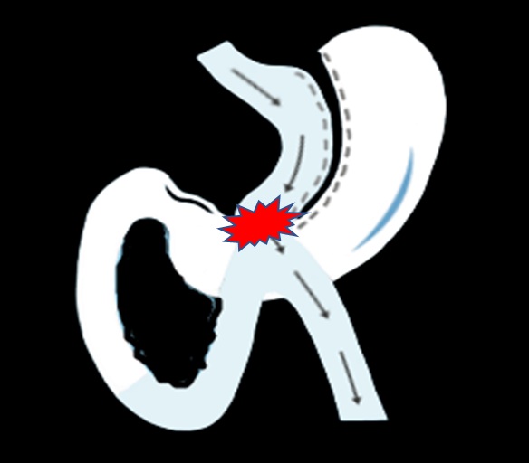
  MARGINAL ULCER (or stomal ulcer)
RISK FACTOR:
Smoking
A large gastric pouch
Gastric fistulas
Use of non-absorbable sutures
Use of non steroid anti-inflamatory or systemic steroid medications
H. pylori infection
Deitel M (Ed.), Essentials of Mini ‒ One Anastomosis Gastric Bypass
2018, Springer International Publishing,

Slide 16

  Controversies in Literature
“This procedure is associated with a high incidence of marginal ulcers (MU) that do not heal on medical management due to the constant exposure of gastrojejunostomy to bile and pancreatic juices.”
Johnson WH, Fernanadez AZ, Farrell TM et al., Surgical revision of loop (“mini”) gastric bypass procedure: multicenter review of complications and conversions to Roux-en-Y gastric bypass.
Surg Obes Relat Dis 2007; 3: 37–41.

Slide 17

  RECENTLY
Marginal ulcers are expected to be less after OAGB due to mixing of gastric juice with bile, alkaline pancreatic secretions and secretions of Brunner’s glands of duodenum.
Baksi, A. et al. Should Surveillance Endoscopy Be Routine After One Anastomosis Gastric Bypass to Detect Marginal Ulcers: Initial Outcomes in a Tertiary Referral Centre. OBES SURG 30, 4974–4980 (2020)
“The patients submitted to an MGB surgery had no increased rates of marginal ulcers when directly compared to the patients submitted to RYGB surgery. “
K.K. Mahawar et al. Marginal ulcers after one anastomosis (mini) gastric bypass: a survey of surgeons. Clin. Obes., 7 (3) (Jun 2017), pp. 151-156,

Slide 18

  TODAY
MOST ACCEPTED INCIDENCE ≈ 2.24%

Slide 19

  WHEN TO OPERATE?
Patients not responding to medical management
PERFORATION!

Slide 20
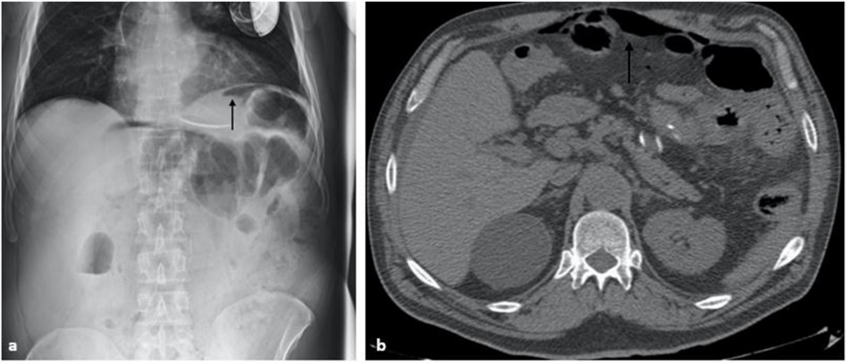
  WHEN TO OPERATE?
MANIFESTATIONS OF PERITONITIS
Abdominal pain or tenderness
Bloating or a feeling of fullness in your abdomen
Nausea and vomiting
Fever
Low urine output
Occlusion
Confusion
SURGICAL
EMERGENCY
IMAGING
Scavone G, Piazza L, et al.. Imaging features in management of laparoscopic mini/one anastomosis gastric bypass post-surgical complications.
Heliyon. 2021 Aug 3;7(8):e07705

Slide 21
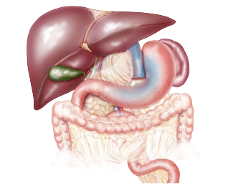
  THERAPEUTIC OPTIONS
Braun’s anastomosis
  (jejuno-jejunal anastomosis ~40–70 cm distal to the GJ anastomosis)
Revision of the GJ
Conversion to RYGB

Slide 22


  OUR EXPERIENCE
TOTAL PATIENTS: 51
27 pz | MA with perforation
10 pz | MA with stenosis
14 pz | MA no responders
ALL PATIENTS TREATED WITH CONVERSION TO RYGB

Slide 23

  Malnutrition
Excessive biliopancreatic limb length and
inadequate postoperative nutritional surveillance have been identified as the main contributors to protein–energy malnutrition and micronutrient deficiencies
Musella et al 0,18 %
Parmar et al 1% mineral malnutrition ,
Gentileschi et al 0,06 %
Piazza L et al 0,62 %
Makkapati et al. 0% , iron and calcium deficiency 2% , and vitamin D deficiency in 15%

Slide 24

  Anemia
Several studies highlighted iron deficiency anemia (IDA) as a significant concern after OAGB
Carandina et al.
reported that nearly 3% of patients had severe anemia that required admission with transfusion.
Kermansaravi et al.
conducted a systematic review of studies reporting iron deficiency (IDA) after OAGB; it was reported that IDA prevalence is 16% and the biliopancreatic limb length predicts IDA rates.

Slide 25
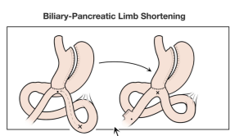
  THERAPEUTIC OPTIONS
Biliary-pancreatic limb shortening (BLS): The distal end of the gastric pouch is stapled and a new anastomosis performed 50–100 cm more proximal, shortening the biliary limb to 150–100 cm
)
Figures reproduced from Gentileschi et al.
Laparoscopic revision after one anastomosis gastric bypass (OAGB): a 4‑years experience in a single high‑volume bariatric surgery center in northern Italy, Updates in Surgery (2025) 77:2097–2105 https://doi.org/10.1007/s13304-025-02329-4

Slide 26

  RESTAURATION
)

Slide 27

  WR/IWL
The true incidence and management of recurrent weight gain following OAGB are unclear. While long-term data remain limited, recurrent weight gain appears to be relatively uncommon
In the study by Makapati et al., only fourpatients (2%) were reported to have recurrent weight gain
Almuhanna et al. reported a conversion
rate of 1% in patients with recurrent weight regain.
Liagre et al. demonstrated that revisional surgery for recurrent weight gain was significantly more frequent after RYGB compared to OAGB (2.4% vs. 0.2%)

Slide 28
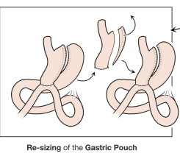
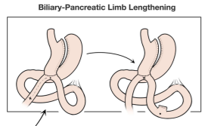
  THERAPEUTIC OPTIONS
Biliopancreatic limb lengthening (conversion to SAGI)
Resizing pouch
Figures reproduced from Gentileschi et al.
Laparoscopic revision after one anastomosis gastric bypass (OAGB): a 4‑years experience in a single high‑volume bariatric surgery center in northern Italy, Updates in Surgery (2025) 77:2097–2105 https://doi.org/10.1007/s13304-025-02329-4

Slide 29
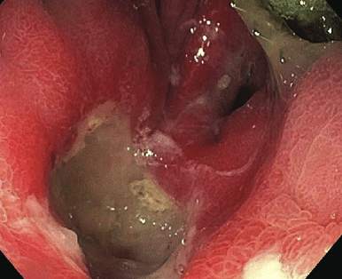
  Excluded-stomach Perforation
Gastric remnant/duodenal perforation after OAGB is rare
It may present without pneumoperitoneum on CT and might present late after surgery (a mean of 118.66±103.93 months ,range 0.17–480, form surgery)
Potential risk: Systemic lupus erythematosus, hypothyroidism, prior peptic ulcer disease, hiatal hernia, renal-transplant immunosuppression, steroid therapy, smoking, and alcohol use, H. pylori status
Excluded-stomach Perforation after Roux-en-Y and One-anastomosis Gastric Bypass: A Systematic Review with Video-illustrated Case Report
Mohamed Hany· Ala Wafa · Mona S. Youssef· · Mohamed Samir et al https://doi.org/10.1007/s11695-026-08725-y

Slide 30
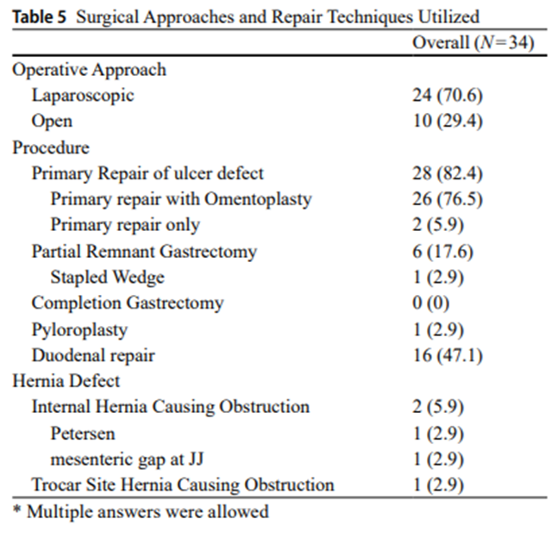
  Excluded-stomach Perforation
Gastric remnant/duodenal pathology and managemen
Ulcerative pathology was the predominant mechanism, accounting for 88.2% of perforations
The duodenal region was the most frequently
involved location (47.1%),
followed by pre-pyloric perforations (11.8%),
antrum (5.9%),
pylorus (5.9%),
and single reports involving the fundus, lesser and greater curvature, and posterior gastric wall
Excluded-stomach Perforation after Roux-en-Y and One-anastomosis Gastric Bypass: A Systematic Review with Video-illustrated Case Report
Mohamed Hany· Ala Wafa · Mona S. Youssef· · Mohamed Samir et al https://doi.org/10.1007/s11695-026-08725-y

Slide 31



  Anastomotic Stenosis
Definition & Presentation: Narrowing of the gastrojejunal anastomosis causing progressive food intolerance, severe nausea, and vomiting months after surgery.
Incidence in Large Series: Reported around 0.06% in large multi-institutional registry evaluations (requiring reoperation/revision), while reaching up to 6.3% in specific comparative mid-term cohorts (e.g., OAGB vs. SADI evaluation)
The defence of body weight:
a physiological basis for weight regain after weight loss
Mean Onset Time: Typically develops at a mean of 8.00 ±4.69 months post-operatively
Revisional Surgery After One Anastomosis/Minigastric Bypass: an Italian Multi‑institutional Survey
Musella et al, Obesity Surgery 2022

Slide 32
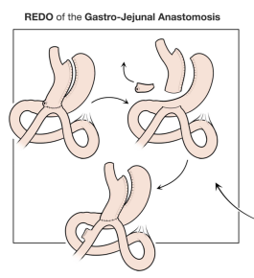
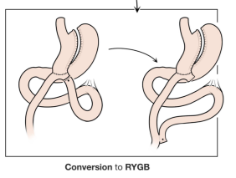
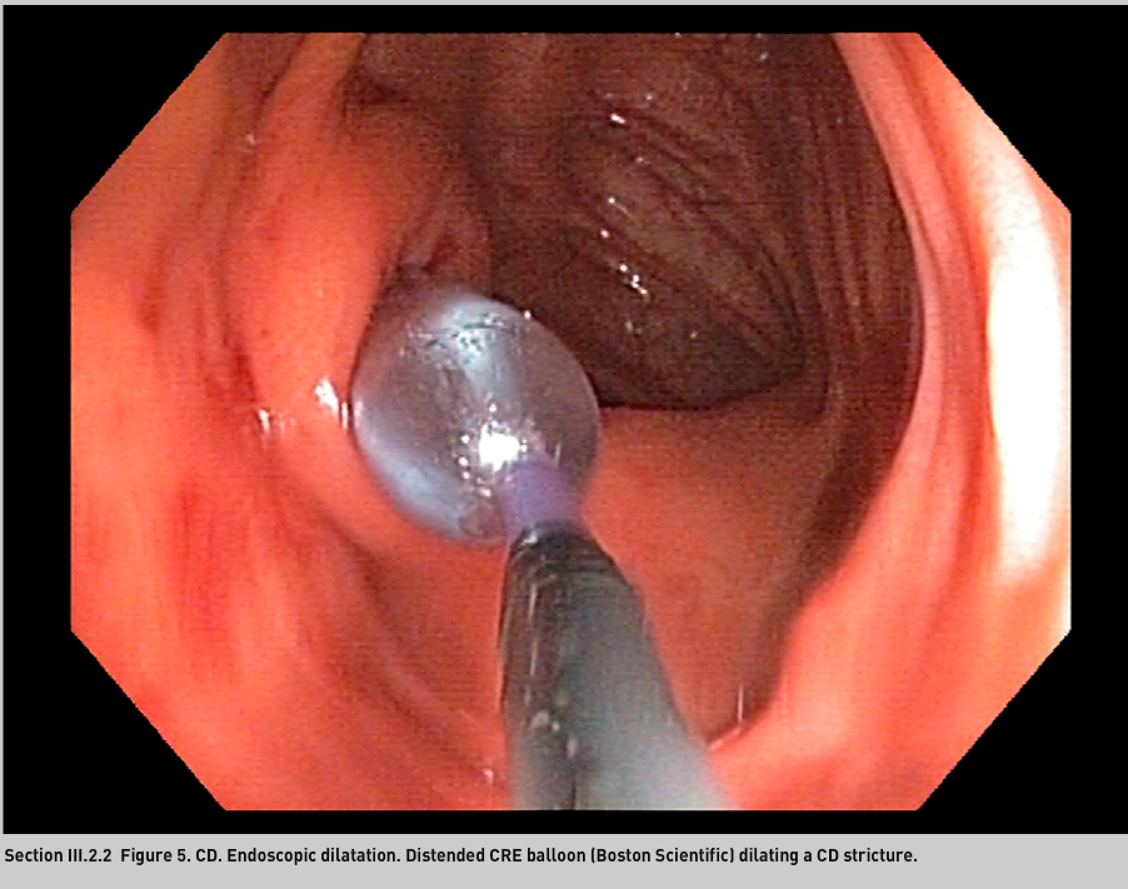
  THERAPEUTIC OPTIONS
Redo of GEA
Conversion To RYGB
Endoscopic balloon dilation (EBD)
Figures reproduced from Gentileschi et al.
Laparoscopic revision after one anastomosis gastric bypass (OAGB): a 4‑years experience in a single high‑volume bariatric surgery center in northern Italy, Updates in Surgery (2025) 77:2097–2105 https://doi.org/10.1007/s13304-025-02329-4

Slide 33

Late complications after OAGB
Diarrhea
Reactive Hypoglycemia
0,03%
Mean onset (months) 16±6,92
First-line: Conservative management (nutritional adjustment, bile acid sequestrants).
Surgical: Bilio-pancreatic limb reduction or conversion to standard RYGB in severe, persistent cases
0,02%
Mean onset (months)5.50 ± 4.94
First-line: Medical management (complex carbohydrate intake, dietary modification).
Surgical: Rare instances; necessitates limb reconfiguration or conversion to restore normal anatomy.
Musella et al, Revisional Surgery After One Anastomosis/Minigastric Bypass: an Italian Multi‑institutional Survey,Obesity Surgery 2022

Slide 34

  CONCLUSIONS
Excellent Safety Profile: The OAGB demonstrates a robust mid-term safety profile with very low rates of severe complications requiring revisional surgery
Revisional Strategy: When reoperation is necessary, the procedure is feasible and effective, but it must be tailored to the specific anatomical or metabolic cause (e.g., limb reduction for malabsorption, or correction of DGER)
The Importance of Experience: Standardized surgical technique and careful patient selection are paramount to minimizing the incidence of late complications and ensuring long-term metabolic success.
Future Perspective: Ongoing multi-institutional monitoring is essential to refine surgical standards and optimize the management of the rare cases that require secondary intervention

Slide 35
THANKS FOR THE ATTENTION AND
HAPPY TO SEE YOU AGAIN!
lpiazza267@gmail.com

